Slide 1
Everyone is a Public Speaker
Justin James DevOps Evangelist Microsoft MVP Professional Speaker

Slide 2
Are we all really public speakers?

Slide 3
I challenge that we are
pair programming
team builders
meetings
report outs
social events
phone calls

Slide 4
effectively communicating your ideas

Slide 5
public speaking is a skill

Slide 6
Skill:
The ability to do something that comes from training, experience, or practice

Slide 7
you can acquire it!

Slide 8
common mistake is giving up too soon

Slide 9
“All great speakers were bad speakers at first”
Ralph Waldo Emerson

Slide 10
more you do it the easier it gets

Slide 11
Over 100 talks since 2014
Notes:
Benefits have been awesome

Slide 12
Travelled over 50,000 miles
Notes:
to 7 states and Norway

Slide 13
Presented at over 50 events

Slide 14
272,000 page views on my blog

Slide 15
Greatly expanded my network

Slide 16
Became a Microsoft MVP

Slide 17
Still on the journey

Slide 18
Still learning

Slide 19
Still growing

Slide 20
Still evolving

Slide 21
4 ingredients

Slide 22
4 ingredients Storytelling

Slide 23
4 ingredients Storytelling Slide crafting

Slide 24
4 ingredients Storytelling Slide crafting Practicing

Slide 25
4 ingredients Storytelling Slide crafting Practicing Delivery

Slide 26
Ingredient #1 Storytelling

Slide 27
write for the stage
Notes:
Language for the eye (to be read) is different from language for the ear (to be heard)

Slide 28
Ditch the Bio Weave it into the Story

Slide 29
“You’ve got 30 seconds before they start asking the question, ‘Am I going to pay attention to you or not?’
John Medina Author of Brain Rules

Slide 30
say it out loud
Notes:
to verify the structure is close to matching the way you would say it

Slide 31
have a point and purpose

Slide 32
“People don’t buy what you do, they buy why you do it”
Simon Sinek Author of Start With Why

Slide 33
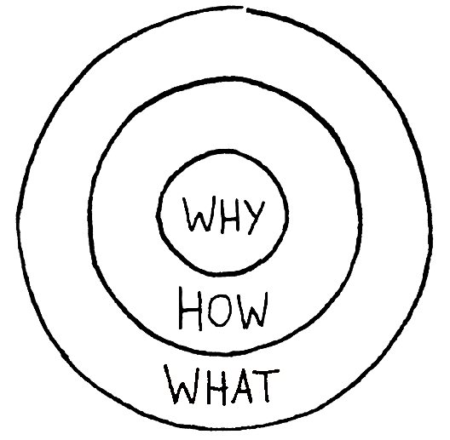
Start With Why
Notes:
Why is it that some leaders and organizations are able to inspire greater loyalty and engagement among their
customers and employees alike? How are they are able to achieve and sustain inordinate amounts of success for years on end?
Whether they realize it or not, all great and inspiring leaders and organizations think, act and communicate in the same way... and it is the complete opposite from everyone else.
Every single organization on the planet, even our own
careers, function on three levels:
1. What we do
2. How we do it, and
3. Why we do it.
When those three pieces are aligned, it gives us a filter through which to make decisions. It provides a
foundation for innovation and for building trust. When all three pieces are in balance, others will say, with
absolute clarity and certainty, “We know who you are,” “We know what you stand for.”
This simple idea is The Golden Circle. It is a concept discovered by optimist and author Simon Sinek.

Slide 34
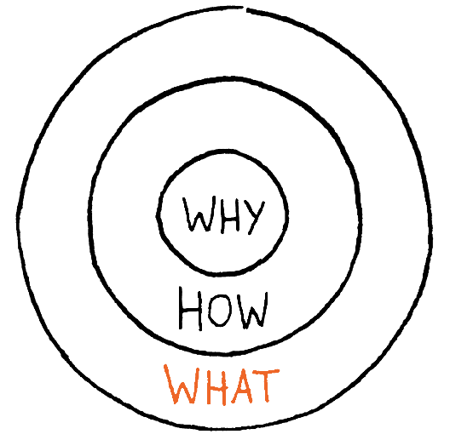
The Golden Circle - What
Products You Sell
Services You Offer
Your Job Title / Roles
Notes:
Every organization and individual knows What they do.
For an organization, these are the products they sell or the services they offer. For an individual, it is their job title or roles.

Slide 35
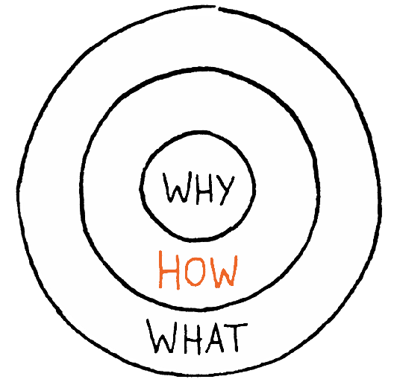
The Golden Circle - How
Make you special
Set you apart
Strengths, values, principles
Notes:
Some know HOW they do what they do. These are the things that make them special or set them apart. The Hows are their strengths, values or guiding principles.

Slide 36
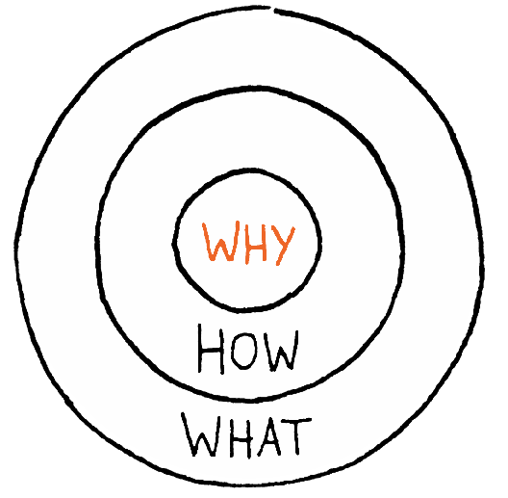
The Golden Circle - Why
Why should I care?
What is in it for me?
Inspires us
Notes:
Why is a purpose, a cause or a belief. The Why is about our contribution to impact and serve others. The Why inspires us.
WHY is not about making money. That’s a result.

Slide 37
Be yourself

Slide 38
Recap - Storytelling
Write for stage
Say it out loud
Have a point and purpose
Start With Why
Be Yourself

Slide 39
Ingredient #2 Slide Crafting

Slide 40
Stay out of PowerPoint

Slide 41
Create structure with mind maps

Slide 42
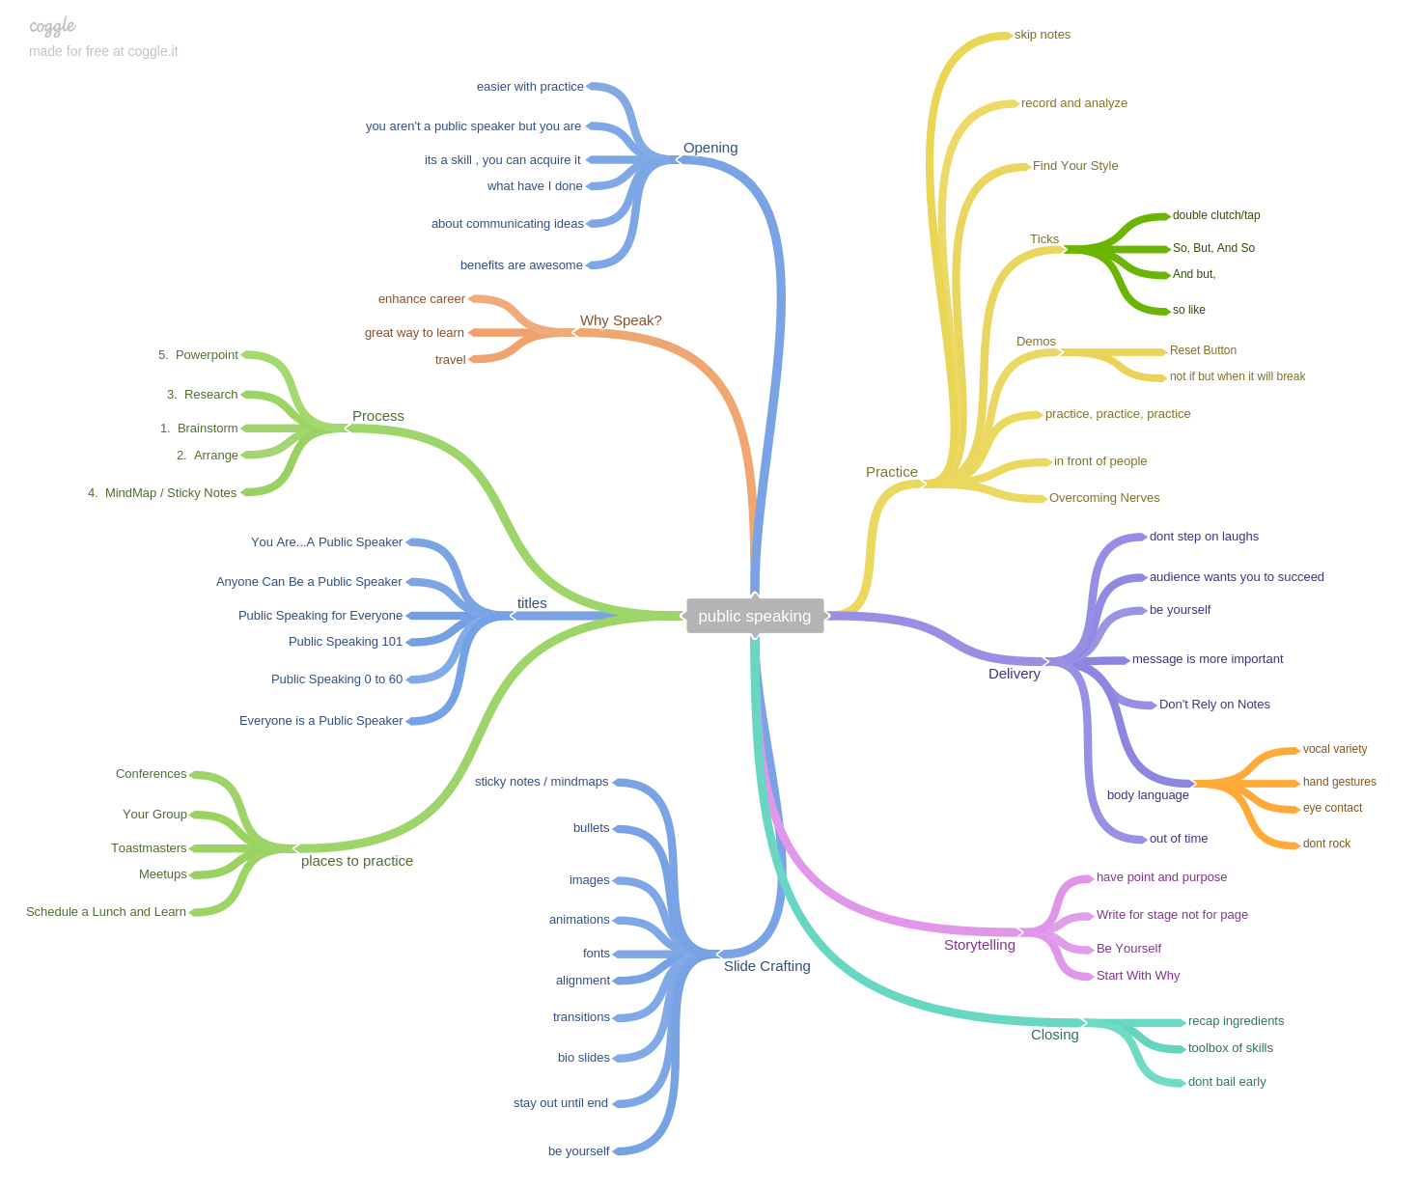
Notes:
One item per branch
Easy to rearrange
Not worried about slide design
Allows you to focus on the message

Slide 43
https://coggle.it/

Slide 44
Now its PowerPoint time

Slide 45
PowerPoint is not Word

Slide 46
1 . Fonts, Fonts, Fonts

Slide 47
Pick appropriate font

Slide 48
Fonts, Fonts, Fonts – 40 pt
Minimum Text Size 24pt
Best Text Size 28-32 pt

Slide 49
2 . Bullet Points

Slide 50
Bullet Points
Keep to a minimum
Keep them short
Make bullets appear as you talk
Use handouts for detailed information

Slide 51
One bullet per slide

Slide 52

Flexible and Configurable
Notes:
https://media.licdn.com/mpr/mpr/AAEAAQAAAAAAAAZ5AAAAJDcyNjRhOWEzLTYzMDktNGJiZC05YTcwLTg5MzkyNjJiNTdkZg.jpg

Slide 53
3. Throw Out Bio Slide

Slide 54
About Me
Web Developer, Microsoft MVP and Professional Speaker
Over 100 talks at conferences and community events
Builds apps in Angular, Sails, ASP.NET, C#
Teacher and student of high quality software development
Blogs at http://digitaldrummerj.me
Follow me on twitter @digitaldrummerj

Slide 55
My Intro for Mobile Web Dev

Slide 56

Mobile represents the single largest technology innovation of all time
10X
Faster than the PC boom
2X
Faster than the Internet boom
3X
Faster than the social networking explosion

Slide 57
I wanted to build a mobile app too!

Slide 58
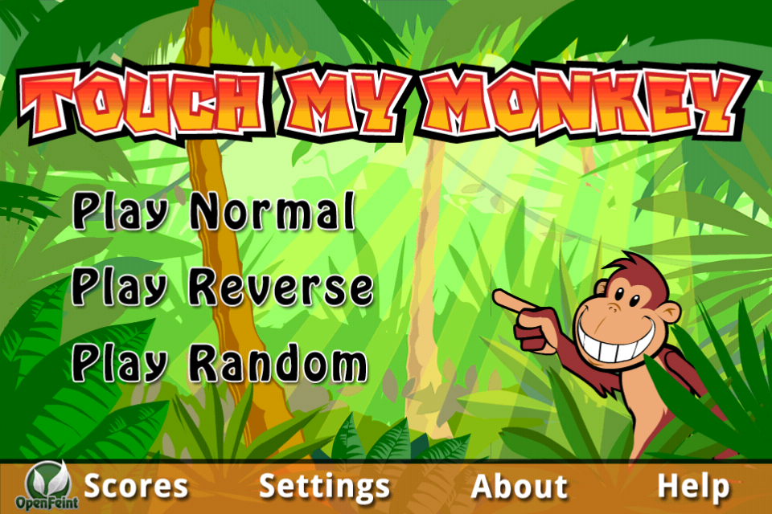

Slide 59


Slide 60
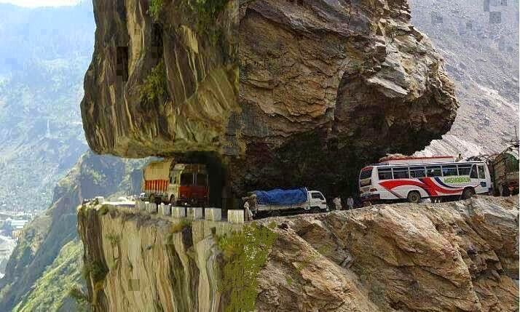

Slide 61


Slide 62


Slide 63
That was way more powerful

Slide 64
“The purpose of the first draft is not to get it right but to get it written.”
John Dufresne Author, Playwriter, Teacher

Slide 65
Be yourself

Slide 66
Recap – Slide Crafting
Story 1st, Powerpoint 2nd
Pick appropriate font - titles 40pt and text 24pt-32pt
Keep bullets to a minimum, short, and appear/dim
Try one bullet per slide
Integrate bio into story
Be yourself

Slide 67
Ingredient #3 Practicing

Slide 68
“It is practice, not talent, that holds the key to success”
Matthew Syed Journalist, Author and Broadcaster

Slide 69
Reduces nerves

Slide 70
Prepares you for any issues

Slide 71
Practice like you are going to present

Slide 72
Don’t just read the slides

Slide 73
Purchase a slide advancer

Slide 74
Purchase a slide advancer Logitech R400

Slide 75
Record your practice with screen and video
Notes:
Camtasia
Google hangouts
Cell Phone

Slide 76
Watch video for ticks

Slide 77
Listen to video for filler words

Slide 78
Listen for double taps

Slide 79
Screen: screencast-o-matic.com Camtasia Quicktime (mac only)

Slide 80
Video: Cell Phone Web Cam Small Camcorder (Zoom Q4HD)

Slide 81
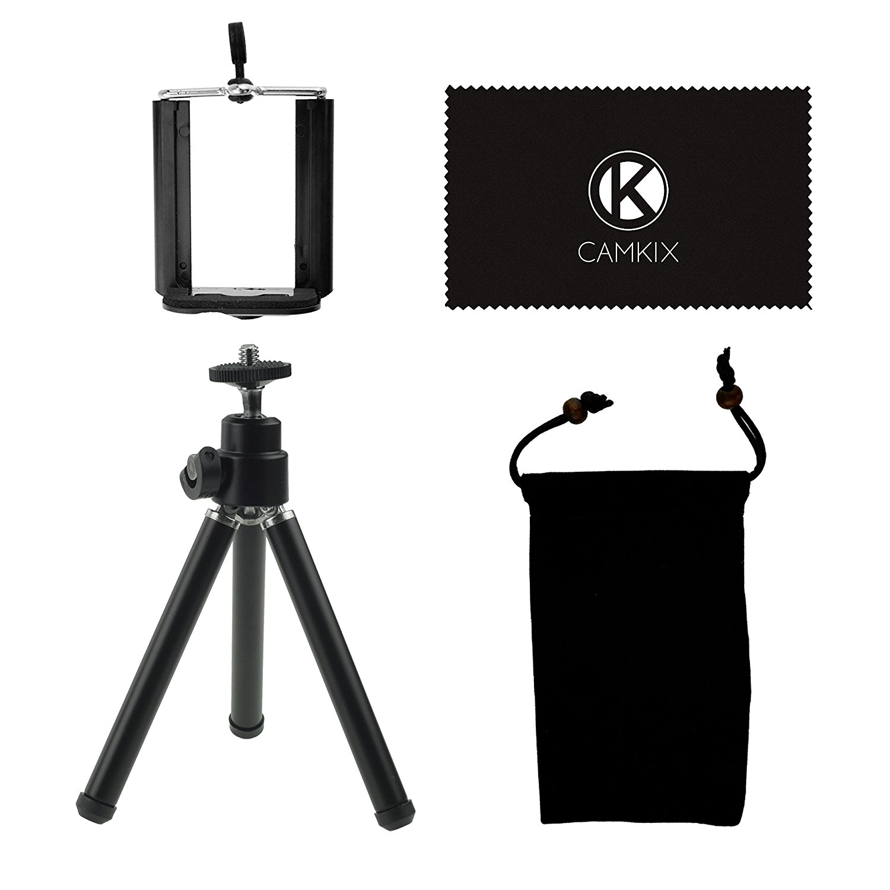
http://bitly.com/iphone-tripod-camkix

Slide 82
You need a place to practice in front of people

Slide 83
Toastmasters

Slide 84
Be yourself

Slide 85
Recap - Practice
Practice like you are presenting
Purchase slide advancer – Logitech R400
Ditch the notes
Record practice
Get in front of people – Toastmasters
Be Yourself

Slide 86
Ingredient #4 Delivery

Slide 87
“The success of your presentation will be judged not by the knowledge you send but by what the listener receives”
Lilly Walter
Author and Professional Speaker
Notes:
The emotions, meaning and application of the words is what causes the reaction in the listener

Slide 88
Be yourself

Slide 89
Smile

Slide 90
Make eye contact

Slide 91
Have vocal variety

Slide 92
Wear something comfortable

Slide 93
Own the stage

Slide 94
Silence is good

Slide 95
Don’t step on your laughs

Slide 96
Don’t hold hands in prayer position

Slide 97
Don’t just read the slides

Slide 98
Perform tech check

Slide 99
Record your speech

Slide 100
Huge secret about audience

Slide 101
They want you to succeed

Slide 102
They want you to succeed They want to pay attention

Slide 103
They want you to succeed They want to pay attention They want to remember your talk

Slide 104
WARNING!!

Slide 105
WARNING!! It is not if something will go wrong

Slide 106
WARNING!! It is not if something will go wrong but WHEN!

Slide 107
S**t…I’m Out of Time

Slide 108
Recap - Delivery
Not just knowledge but what audience receives that matters
Be Yourself
Do a tech check
Audience has your back
Not if but when something will go wrong
Don’t rush at end

Slide 109
We are all public speakers

Slide 110
public speaking isn’t just one skill, it is a toolbox of skills

Slide 111
4 ingredients Storytelling Slide Crafting Practicing Delivery

Slide 112
It will become easier

Slide 113
You will craft speeches quicker

Slide 114
1st draft will be closer to final

Slide 115
Don’t bail out and give up

Slide 116
“I have not failed 10,000 times. I have not failed once. I have succeeded in proving that those 10,000 ways will not work”
Thomas Edison

Slide 117




Thank you slideshare.net/digitaldrummerj
digitaldrummerj.me
digitaldrummerj

